Slide 1
APPLIED DATA SCIENCE 1 • 7FTC2004
Data Exploration &
Visualisation
TRUONG TAN PHAT | 9027KVDX
Tutor: Wong Kim Siong
PSB Academy • University of Hertfordshire
Submission: October 2026
Retail Store Sales Analysis
A data-driven investigation into omnichannel sales performance, customer purchasing patterns, and transaction distributions (2022–2025)
VIEW PUBLIC GITHUB REPOSITORY ↗
github.com/overwatch093-alt/ADS1-Assignment1-Retail-EDA
Notes:
Introduce project scope and modular code availability.

Slide 2
01 • PROJECT FRAMING
02 / 12
From raw transactions to decisions
12,575
11
8
2022–25
RAW RECORDS
FEATURES
RETAIL CATEGORIES
ANALYSIS PERIOD
AUDIT
EXPLORE
Clean without introducing bias
Describe relationships, categories and distributions
MODULARISE
ACT
Reusable Python functions for every plot
Translate evidence into practical recommendations
Notes:
Emphasise transformation from raw data to actionable insights.

Slide 3
02 • DATA QUALITY
03 / 12
Missingness is concentrated—not random noise
FEATURE
COUNT
MISSING %
TREATMENT
Discount Applied
4,199
33.39%
Treat as False
Item
1,213
9.65%
Unspecified Item
Price Per Unit
609
4.84%
Recover by division
PRICE = TOTAL SPENT ÷ QUANTITY
Quantity & Total Spent
604
4.80%
Drop incomplete rows
IDs, category, payment, location, date
0
0.00%
Complete
0 exact duplicate rows • 0 duplicate Transaction IDs
Transaction Date arrived as DD/MM/YYYY text and required explicit day-first parsing.
Notes:
Explain missingness patterns and implications.

Slide 4
03 • METHODOLOGY
04 / 12
A defensible five-step cleaning pipeline
01
02
03
04
05
RECOVER PRICE
NORMALISE DISCOUNT
LABEL ITEMS
PARSE TIME
FILTER
Total Spent ÷ Quantity
for 609 rows
NaN → False
for 4,199 rows
Missing names →
“Unspecified Item”
dayfirst=True; derive
Year + YearMonth
Drop 604 rows missing
Total Spent
11,971
13 columns • no missing values
CLEAN TRANSACTIONS
Notes:
Highlight careful imputation to preserve data integrity.

Slide 5
04 • SUMMARY DASHBOARD
05 / 12
Performance is broad-based across categories
$129.65
$94.75
5.54
MEAN ORDER SPEND
SAMPLE STANDARD DEVIATION
AVERAGE BASKET SIZE
CATEGORY
TRANSACTIONS
TOTAL REVENUE
AVG SPEND
Butchers
1,496
$208,118.00
$139.12
Electric Household Essentials
1,516
$203,813.50
$134.44
Beverages
1,496
$197,047.50
$131.72
Furniture
1,525
$195,310.00
$128.07
Food
1,507
$194,812.00
$129.27
Computers & Electric Accessories
1,477
$190,692.50
$129.11
Patisserie
1,441
$182,165.50
$126.42
Milk Products
1,513
$180,112.00
$119.04
Notes:
Highlight even revenue distribution and category rankings.

Slide 6
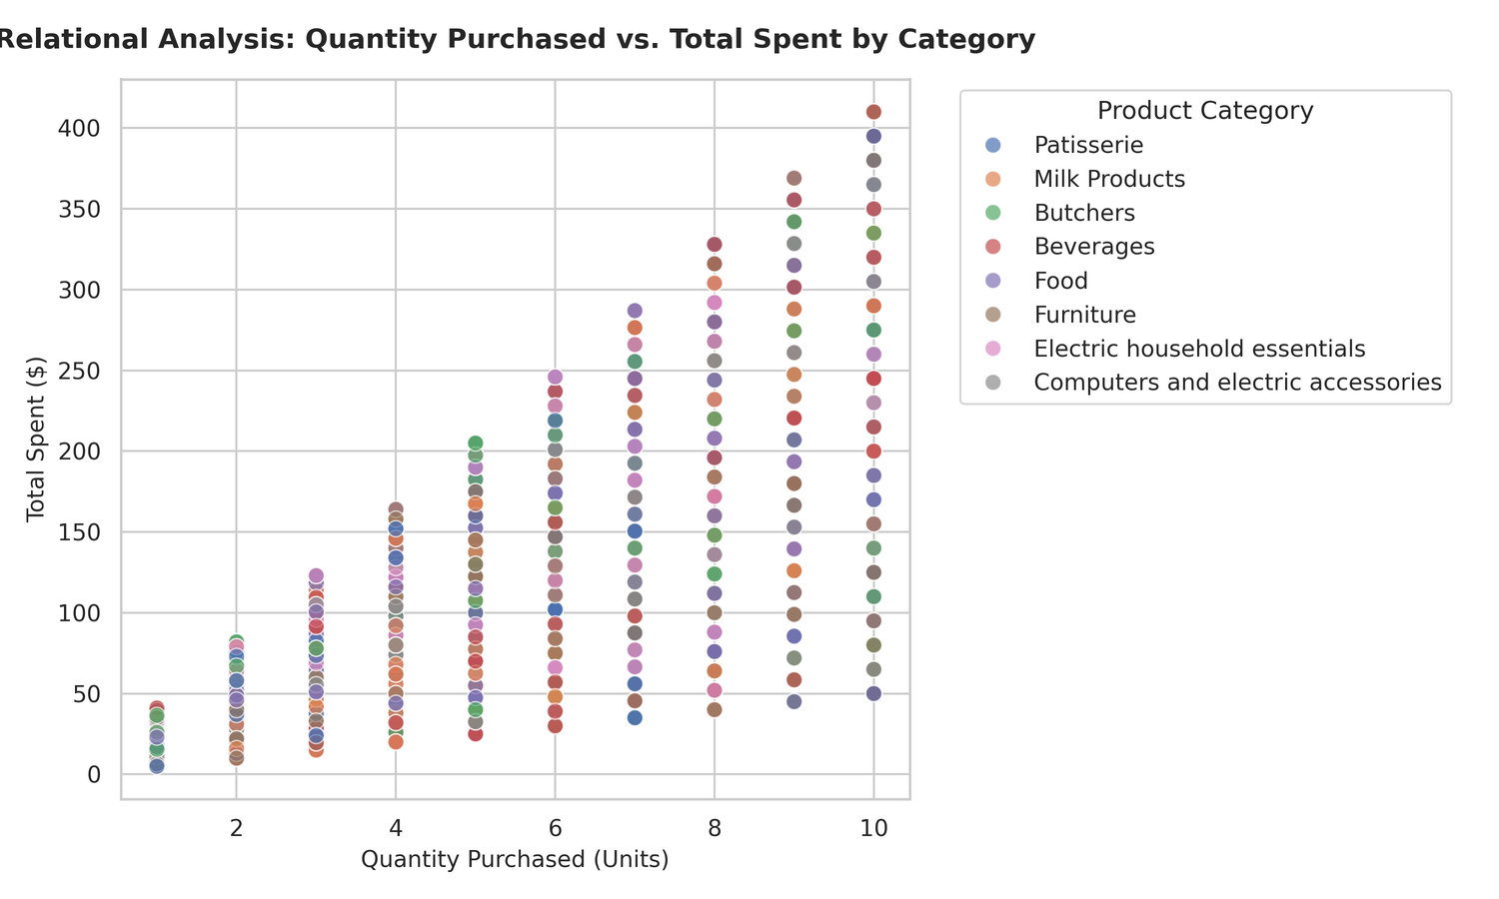
05 • RELATIONAL ANALYSIS
06 / 12
Quantity is the primary spend driver
r = +0.712
STRONG POSITIVE
• Price per unit vs quantity: r = +0.015
• Discrete quantities 1–10 create fan-shaped vertical columns
• Unit price controls the vertical range at each quantity
Notes:
Emphasise volume as primary driver; clarify no unsupported correlations.

Slide 7
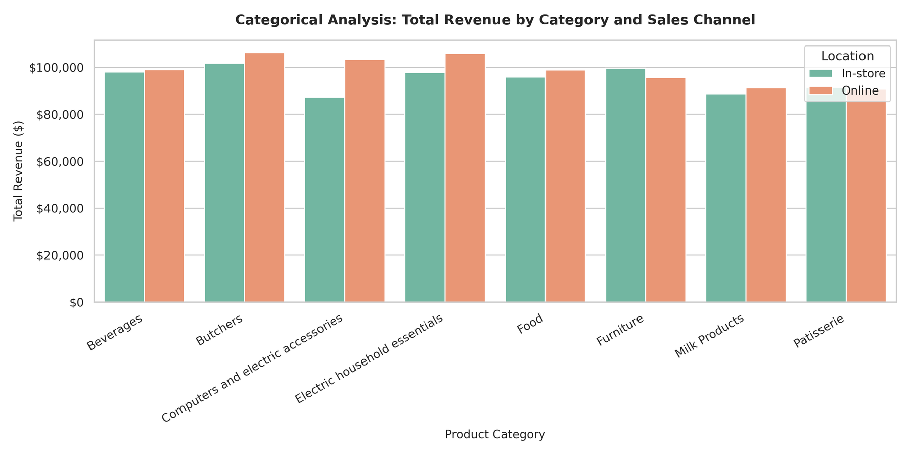
06 • CATEGORICAL ANALYSIS
07 / 12
Omnichannel parity spans every category
≈ 50 / 50
ONLINE / IN-STORE
Top in-store
Butchers • $101,777
Top online
Butchers • $106,341
Evidence supports mature omnichannel behaviour; no causal claim is made.
Notes:
Explain channel parity across retail sectors.

Slide 8
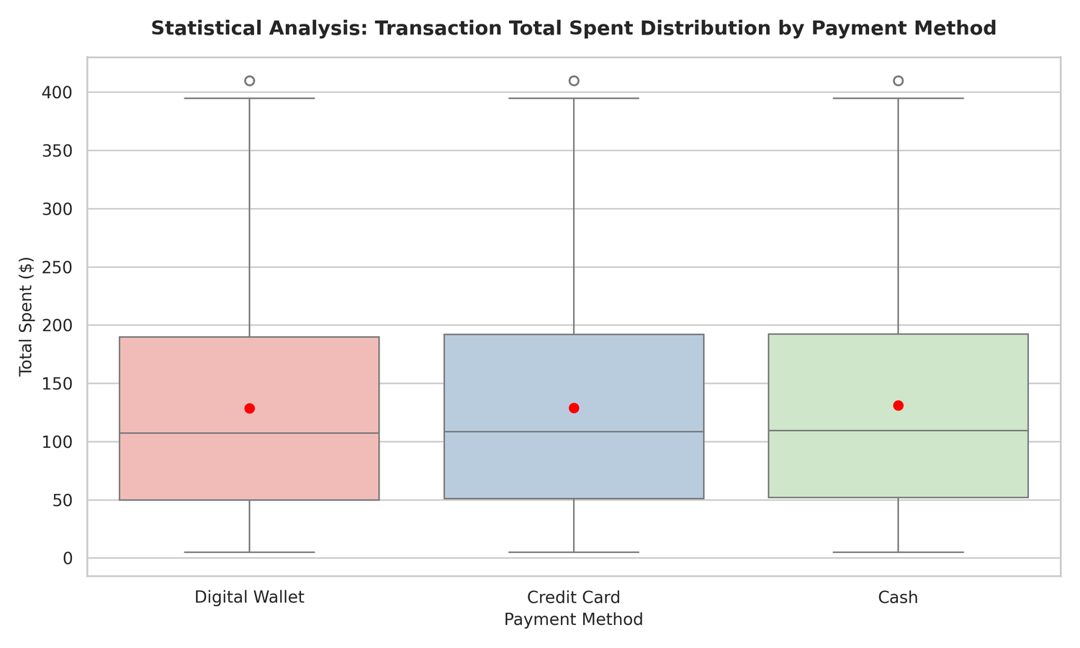
07 • STATISTICAL ANALYSIS
08 / 12
Payment choice does not constrain order size
METHOD
Q1
MEDIAN
MEAN
Cash
$52.00
$109.50
$131.05
Credit Card
$51.00
$108.50
$129.13
Digital Wallet
$50.00
$107.50
$128.72
Similar IQRs and upper values (~$410). Positive skew is consistent: means exceed medians.
Notes:
Confirm spending distributions equivalence across payment methods.

Slide 9
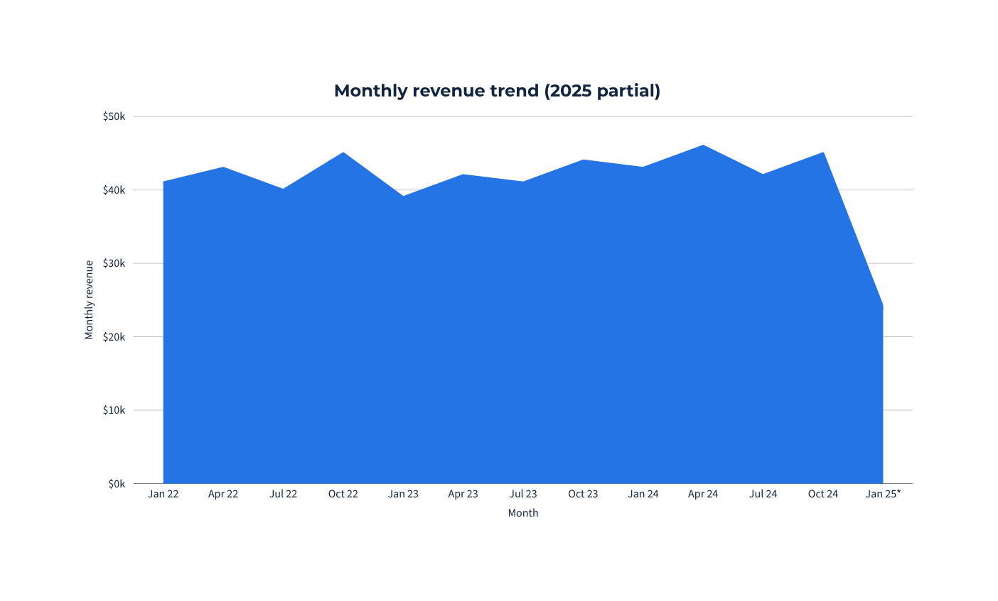
08 • TIME SERIES
09 / 12
Revenue remains stable across three full years
$1.552m
CLEANED TOTAL
$510,329.50
2022
$491,312.00
2023
$524,881.00
2024
Typical month: ~$38k–$46k • no severe seasonal dips • 2025 data ends 18 Jan
Notes:
Highlight revenue stability and steady monthly demand.

Slide 10
09 • STRATEGIC ACTION
10 / 12
Three low-risk moves grounded in evidence
01
02
03
OMNICHANNEL SUPPLY CHAIN
CROSS-CATEGORY BUNDLING
PAYMENT FRICTION
Finding
Finding
Finding
≈50% Online / 50% In-Store
Similar unit volumes across sectors
Order distributions are equivalent
Action
Action
Action
Unify inventory buffers across both channels
Pair electronics with high-frequency perishables
Avoid wallet and card transaction fees
Benefit
Benefit
Benefit
Seamless fulfilment
Higher basket value
Frictionless checkout
Notes:
Recommendations balance data without overstating conclusions.

Slide 11
10 • REPRODUCIBILITY
Modular code. Public evidence.
def generate_relational_plot(df: pd.DataFrame,
output_name: str = "relational_plot.png") -> None:
"""Scatter quantity versus total spend by category."""
fig, ax = plt.subplots(figsize=(10, 6))
sns.scatterplot(data=df, x="Quantity",
y="Total Spent", hue="Category", ax=ax)
ax.set_title("Quantity Purchased vs. Total Spent")
fig.tight_layout()
fig.savefig(output_name, dpi=300)
plt.close(fig)
FUNCTIONS
generate_relational_plot
generate_categorical_plot
generate_statistical_plot
LIBRARIES
pandas • numpy
matplotlib • seaborn
REPOSITORY
├─ retail_store_sales Assignment 1.csv
├─ eda_pipeline.py
├─ relational_plot.png
├─ categorical_plot.png
├─ statistical_plot.png
└─ README.md
VIEW PUBLIC GITHUB REPOSITORY ↗
https://github.com/overwatch093-alt/ADS1-Assignment1-Retail-EDA
Notes:
Emphasise modular, documented, reproducible codebase.

Slide 12
11 • RESPONSIBLE PRACTICE
University of Hertfordshire
GenAI Policy Compliance
AI TOOL USED
SPECIFIC PURPOSE
EXTENT & SCOPE
ChatGPT / Gemini
Python code syntax & formatting
Syntax validation of pandas & seaborn code
ChatGPT / Gemini
Grammar & spelling proofreading
Review of presentation slide text
Thank you for your time.
QUESTIONS WELCOME
Notes:
Politely end presentation and invite questions.

